Slide 1
Unit 3 System Analysis in OOAD
Hour: 5 hour
Presented by
Er.Harendra Bikram Shah (Lecturer)
Department of BCA NAST

Slide 2
OUTLINES
Requirements in Object-Oriented Systems
Identifying functional and non-functional requirements in object-oriented systems.
Use of Use Case Diagrams to model system requirements.
Requirement Modeling in OOAD
Creating Use Case Descriptions and Use Case Diagrams in UML for capturing functional requirements.

Slide 3

INTRODUCTION TO OOAD
Combination of OOA and OOD .
Way to design software by thinking of everything as objects similar to real-life things.
Helps make software easier to manage, reuse, and grow.

Slide 4
Important Aspects of OOAD
Object-Oriented Programming: items are mapped as software objects with attributes and methods that relate to their actions.
Design patterns : Used by OOAD to help developers in building software systems that are more efficient and maintainable.
UML diagrams: Used in OOAD to represent the different components and interactions of a software system.
Uses cases: Helps developers to understand the requirements of a system and to design software systems that meet those requirements.

Slide 5
Introduction To Object Oriented Analysis
Process of understanding and analyzing the system requirements by looking at the problem scenario in terms of objects.
These objects represent real-world entities that are relevant to the system being developed.
the goal is to identify the objects, their attributes, behaviors, and relationships, without focusing on how the system will be implemented.
Object-Oriented Design
Process of implementation of the conceptual model developed in OOA.
Two specific aspects of OOD are:
Data Organization of Attributes:
specifies how data attributes are organized within the objects.
determines the types of data each object will hold and how they relate to one another.
Procedural Description of Operations:
OOD requires a procedural description for each operation that an object can perform.
This involves detailing the steps or processes involved in carrying out specific tasks.

Slide 6
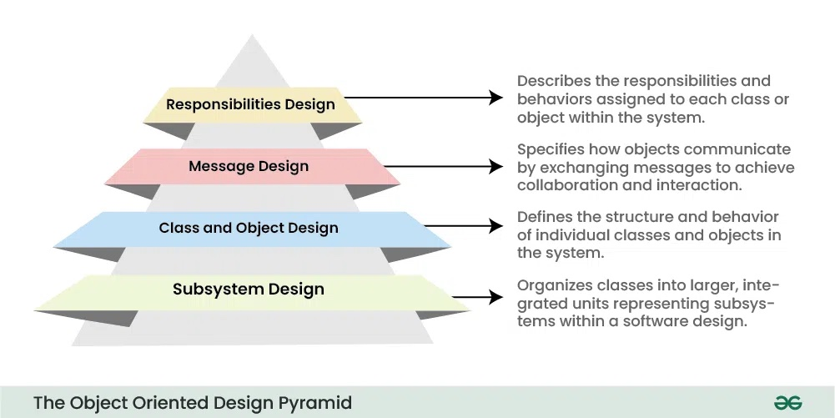
Introduction To Object Oriented Design

Slide 7
Examples of Object-Oriented Analysis and Design
E-commerce Application (e.g., Amazon)
Car Rental System (e.g., Hertz)
Hospital Management System
Library Management System
College Management System

Slide 8

Introduction To System Analysis and Design
Process of collecting and interpreting facts, identifying the problems, and decomposition of a system into its components.
Conducted for the purpose of studying a system or its parts in order to identify its objectives.
Analysis specifies what the system should do.
Systems Design
System Design focuses on how to accomplish the objective of the system.

Slide 9
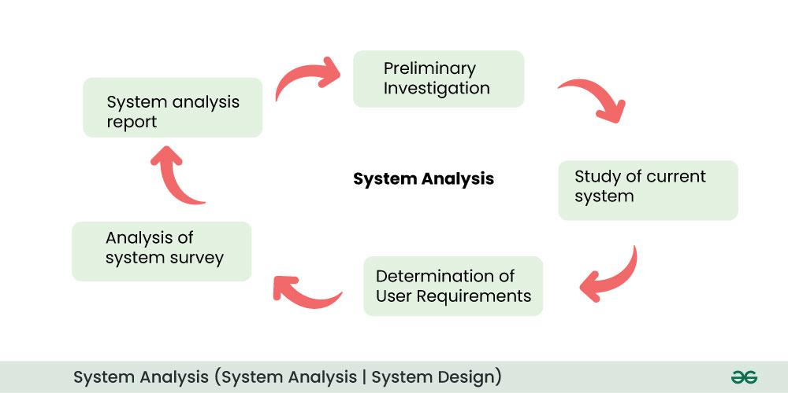
Introduction To System Analysis and Design
key aspects of system analysis are:
Problem Identification:
Requirements Gathering:
Feasibility study:
Analysis and modeling:
Scope Definition:

Slide 10
Introduction To System Analysis and Design
The main components of system design are as follows:
Architecture design:
Database configuration:
Communication system:
Algorithm Design:
Security:
Test and Maintenance:
Documentation:

Slide 11
Introduction To System Analysis in OOAD
first major phase in the Object-Oriented Analysis and Design (OOAD) process.
In the OOAD context, System Analysis focuses on understanding what the system should do by analyzing the problem domain through object-oriented concepts like classes, objects, use cases, and interactions.
Key Objectives of System Analysis in OOAD:
Understand the Problem Domain:
Identify Objects and Classes:
Define Use Cases:
Model System Behavior:
Establish System Boundaries:

Slide 12
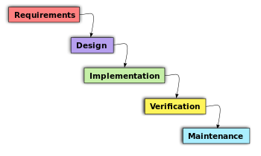
Introduction To Object Oriented System
In OOS ,software developer focuses on the task, not on the tools and it organizes the application on the basis of OO Concepts.
The behavior of the System depends on the collaboration between different Objects.
Phases of Object-Oriented Software Development

Slide 13
Requirements in Object Oriented System
Requirements in Object-Oriented Systems are the functional and non-functional needs of a software application
described and modelled using object-oriented concepts like objects, classes, inheritance, encapsulation, and polymorphism.
Purpose of Requirements in OOS:
Clarify the system's goals and boundaries.
Guide the design of classes, methods, and object interactions.
Ensure alignment with business objectives.
Support maintainability and reusability through proper OO structure.
Advantage
Improved Understanding
Traceability
Reusability
Better Communication
Change Management
Maintainability

Slide 14
FUNCTIONAL REQUIREMENTS IN OBJECT-ORIENTED SYSTEMS.
Functional requirements describe the specific functions, features, and behavior that a software system must perform.
They define ”what the system should do”
Key Characteristics of Functional Requirements:
Describe system behavior and interactions.
Are user- and system-focused.
Can be captured using use cases, user stories, or detailed descriptions.
Directly map to features and functions to be implemented in code.
Functional Area | Examples
User Authentication | Login, logout, password reset
Data Management | Create, Read, Update, Delete (CRUD) operations
Report Generation | Generate invoices, reports, statistics
Business Rules | Discount calculations, tax application
Communication | Send emails, notifications, alerts
Search & Filter | Search database records, apply filters
Transactions | Bank transfers, e-commerce checkouts

Slide 15
NON-FUNCTIONAL REQUIREMENTS IN OBJECT-ORIENTED SYSTEMS.
Non-Functional Requirements specify ”how a system performs its functions” rather than what it does.
They define the quality attributes of a system such as performance, reliability, security, scalability, and usability.
Key Characteristics:
Define system qualities or constraints.
Often apply system-wide rather than to individual functions.
Measured by metrics (e.g., response time, uptime percentage).
Help determine user satisfaction, system acceptance, and success.

Slide 16
NON-FUNCTIONAL REQUIREMENTS IN OBJECT-ORIENTED SYSTEMS.
Type | Description | Example
Performance | Speed, response time, throughput | "Page must load within 2 seconds."
Scalability | Ability to grow and handle increasing loads | "System should support 10,000 users simultaneously."
Security | Protection against unauthorized access, data integrity | "Users must log in using two-factor authentication."
Availability | System uptime and fault tolerance | "System must be available 99.9% of the time."
Usability | Ease of use and learnability for users | "New users should learn to use the system within 30 mins."
Maintainability | Ease of fixing bugs and updating system | "Code should be modular and documented for easy updates."
Portability | Ability to run on different platforms | "System must run on Windows, Linux, and macOS."
Reliability | Ability to operate consistently and correctly | "System must operate without failure for 1,000 hours."
Compliance | Adherence to legal, regulatory, or standards requirements | "Must comply with GDPR and ISO 27001."

Slide 17
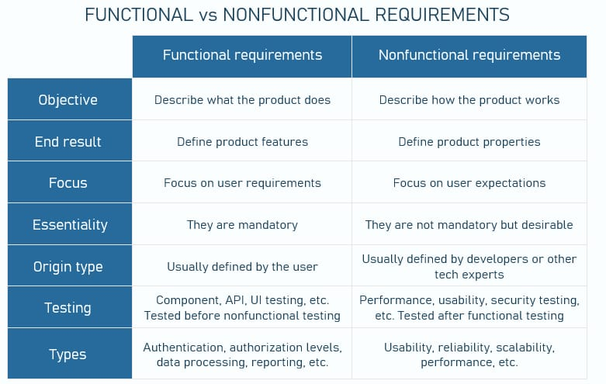
Identifying functional and non-functional requirements in object-oriented systems.

Slide 18

Use Case Diagrams
illustrates the interactions between users (actors) and a system.
They are crucial for defining system scope and requirements.
Purpose of Use Case Diagrams
Identify system functionalities (what the system should do)
Define interactions between users (actors) and the system
Serve as a blueprint during requirements gathering and system design
Provide a clear and visual representation of system behavior

Slide 19
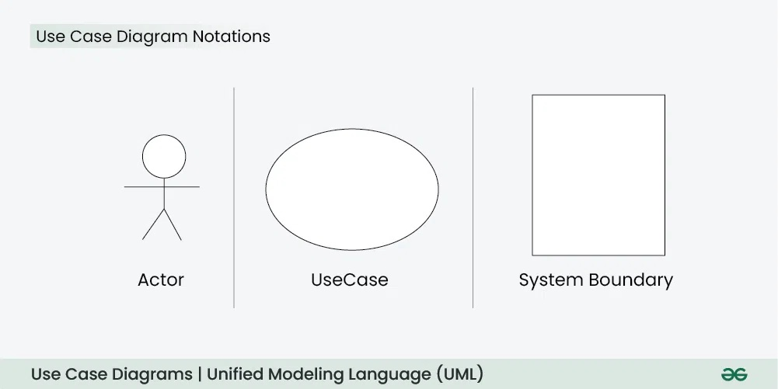
Use Case Diagrams

Slide 20
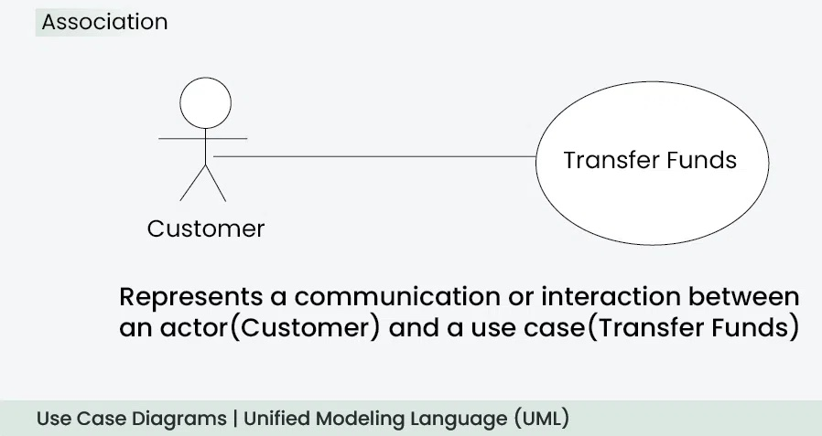
Use Case Diagrams
When to apply Use Case Diagram?
When you need to gather and clarify user requirements
If you’re working with non-technical stakeholders
During the system design phase, use case diagrams helps to outline user interactions and plans the features
When defining what is included in the system versus what is external.
Use Case Diagram Relationships
The Association Relationship represents a communication or interaction between an actor and a use case.

Slide 21
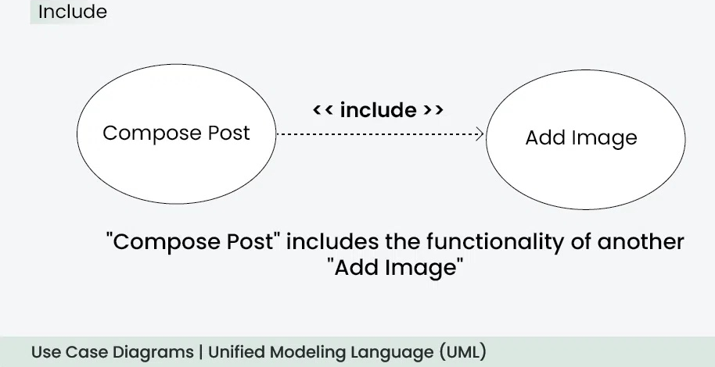
Use Case Diagrams
2. Include Relationship
The Include Relationship indicates that a use case includes the functionality of another use case.

Slide 22
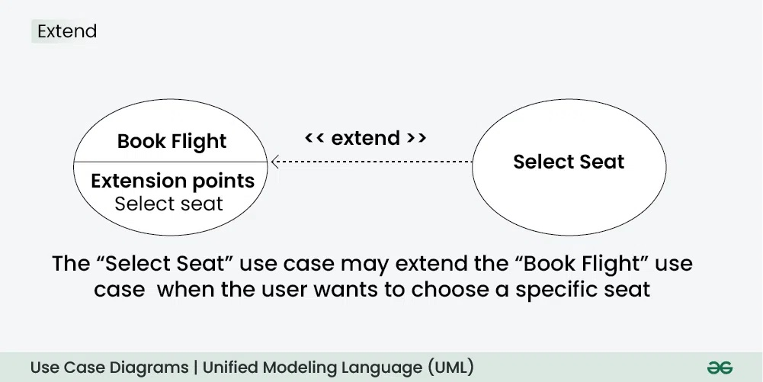
Use Case Diagrams
3. Extend Relationship
The Extend Relationship illustrates that a use case can be extended by another use case under specific conditions.

Slide 23
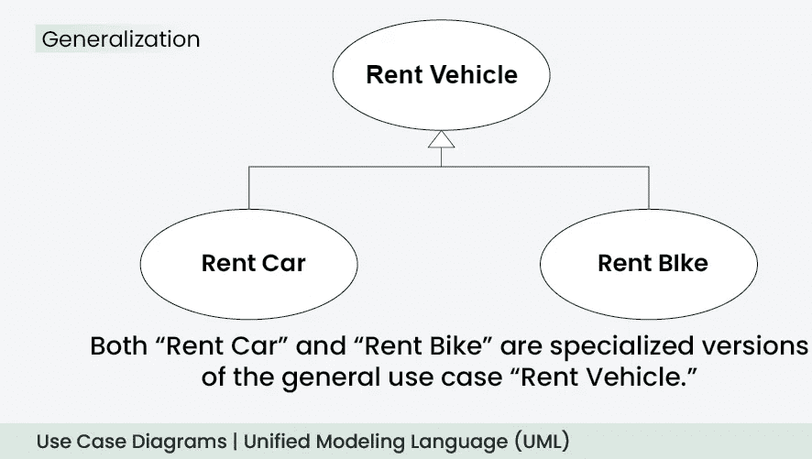
Use Case Diagrams
4. Generalization Relationship
The Generalization Relationship establishes an "is-a" connection between two use cases, indicating that one use case is a specialized version of another.

Slide 24
Benefits of Using Use Case Diagrams
Benefit | Description
Clarifies Functional Requirements | Shows what users can do and how the system responds
Stakeholder Communication | Easy for non-technical users to understand
Scope Definition | Helps define what the system will and won’t do
Basis for Test Cases | Each use case can become a test scenario
Foundation for Design | Guides class diagrams, sequence diagrams, etc.

Slide 25
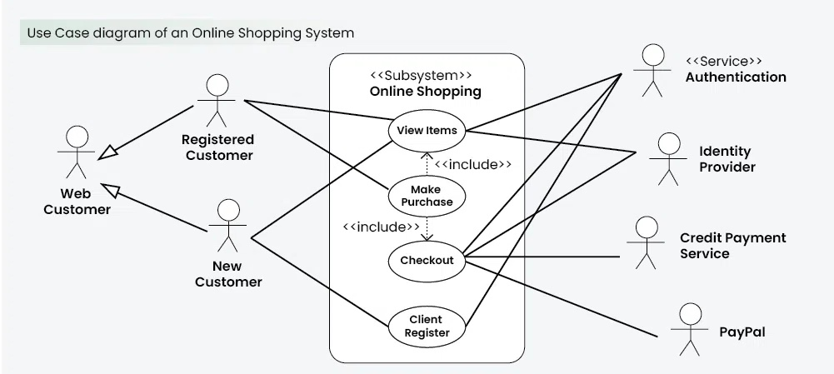
Example of Use Case Diagrams

Slide 26
Requirement Modeling in OOAD
It is the process of capturing, analyzing, and representing what the system is supposed to do (functional) and how it should behave (non-functional), using object-oriented concepts.
Purpose of Requirement Modeling in OOAD
Understand what the system should do
Identify system functionalities and constraints
Discover and define user roles, system boundaries, and interactions
Prepare for object-oriented design by identifying classes, objects, and relationships
Requirement Modeling Techniques in OOAD
Technique | Description
Use Case Diagrams | Show actors and system interactions (functional behavior)
Class Diagrams | Identify entities (objects/classes), attributes, and relationships
Activity Diagrams | Model the workflow or business processes
Sequence Diagrams | Show how objects interact over time for a specific scenario
State Diagrams | Show object states and transitions based on events

Slide 27
Creating Use Case Descriptions and Use Case Diagrams in UML for capturing functional requirements.
A Use Case Description is a detailed, structured narrative that explains how a system interacts with users (actors) to achieve a specific goal.
It outlines the steps, interactions, and possible variations in a scenario where a user engages with the system.
Key Components of a Use Case Description
Use Case Name – A clear, action-oriented title (e.g., "Place Order").
Actor(s) – Who interacts with the system (e.g., Customer, Admin).
Description – A brief summary of the use case.
Preconditions – Conditions that must be true before the use case starts.
Basic Flow (Main Success Scenario) – Step-by-step normal execution path.
Alternative Flows – Variations or exceptions (e.g., "Payment fails").
Postconditions – The state of the system after the use case completes.

Slide 28
Creating Use Case Descriptions and Use Case Diagrams in UML for capturing functional requirements.
Importance of Use case Descriptions
Clarify system behavior for developers, testers, and stakeholders.
Identify requirements and potential errors early.
Guide testing by defining expected flows and exceptions.
Improve communication between business and technical teams.
Steps to Create Use Case Descriptions & Diagrams
Identify Actors (Who interacts with the system?)
List Use Cases (What functionalities are needed?)
Write Use Case Descriptions (Detail steps, exceptions)
Draw Use Case Diagram (Visualize interactions)
Validate with Stakeholders (Ensure accuracy)

Slide 29
Creating Use Case Descriptions and Use Case Diagrams in UML for capturing functional requirements.
Purposes/Application of Use Case Diagrams
1. Capture Functional Requirements
Identify what the system should do from the user’s perspective.
Example:
In an Online Shopping System, use cases include:
Browse Products
Add to Cart
Checkout
2. Define System Scope
The system boundary (rectangle) separates internal functionality from external actors.
3. Identify Actors & Their Roles
Primary Actors: Directly interact with the system (e.g., Customer, Admin).
Secondary Actors: Support the system (e.g., Payment Gateway, Email Service).
4. Model Interactions & Relationships
Association: Links actors to use cases.
«Include»: Mandatory dependency
«Extend»: Optional behavior

Slide 30
Creating Use Case Descriptions and Use Case Diagrams in UML for capturing functional requirements.
5. Support Requirement Analysis & Validation
Helps stakeholders (business analysts, developers, testers) understand system behavior.
Ensures no missing functionalities before development starts.
6. Guide System Design & Testing
Developers use it to design classes and methods.
Testers derive test cases from use case flows.

Slide 31
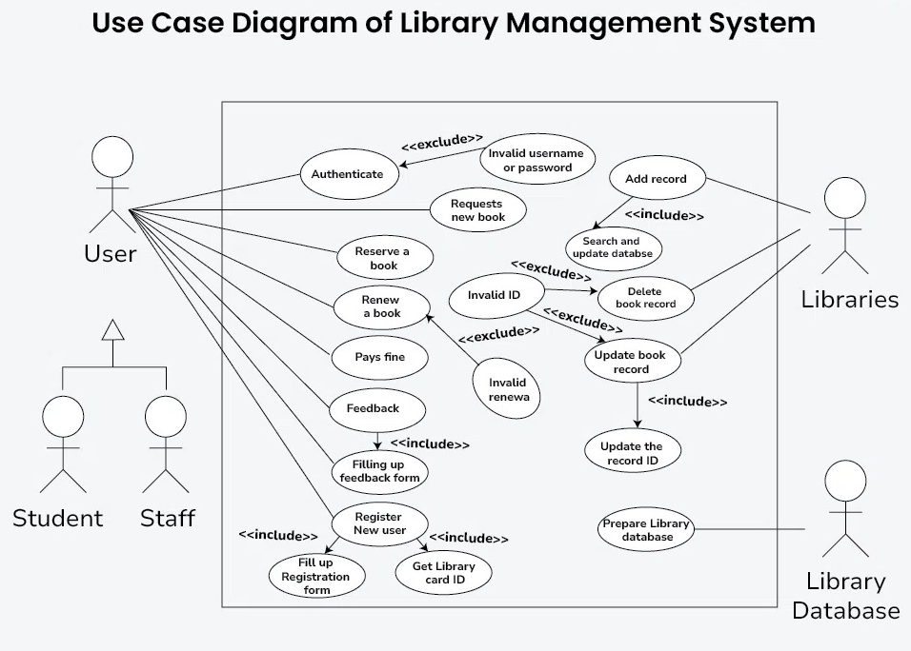
Example of Use Case Diagrams

Slide 32
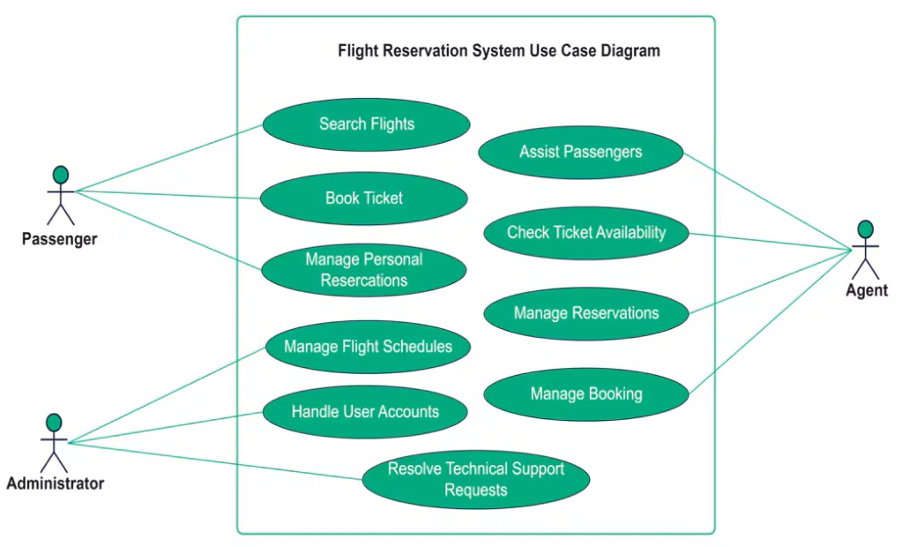
Example of Use Case Diagrams

Slide 33
End of The Unit

Slide 34
THANK YOU

